Slide 1
Local Search (2)
Shaowei Cai, UCAS, 2020

Slide 2
The Cycling Problem of Local Search
Cycling problem, i.e., revisiting candidate solutions
A key factor to bad performance
wastes time
prevents it from getting out of local minima
Cycling is an inherent problem of local search
local search does not allow to memorize all previously visited parts of the search space.

Slide 3
Previous Methods to deal with cycling
Naive methods
Random walk
Non-improving search
Restart
The tabu mechanism
forbids reversing the recent changes, where the strength of forbidding is controlled by a parameter called tabu tenure [1989].

Slide 4
Address cycling problem by Configuration Checking (CC) [2011].
CC is found effective for the following types of problems:
Assignment Problems: to find an assignment to all variables such that satifises the constraints (and optimized).
Subset Problems: to find a subset from a universe set such that satisfies the constraints (and optimized).

Slide 5

A simple CC for SAT
$N\left(x\right)=\{y|y and x occur in at least one clause\}$
configuration: the configuration of a variable $x$ is a vector $C_{x}$ consisting of truth value of all variables in $N(x)$ under current assignment s (i.e., $C_{x} = s{\left.​\right|}_{N(x)}$).
A simple CC for SAT: if the configuration of $x$ has not changed since $x$'s last flip, then it should not be flipped.

Slide 6
Use CC
to filter candidate variables
to give preference to CC variables
Used in many successful local search SAT and MaxSAT algorithms.

Slide 7
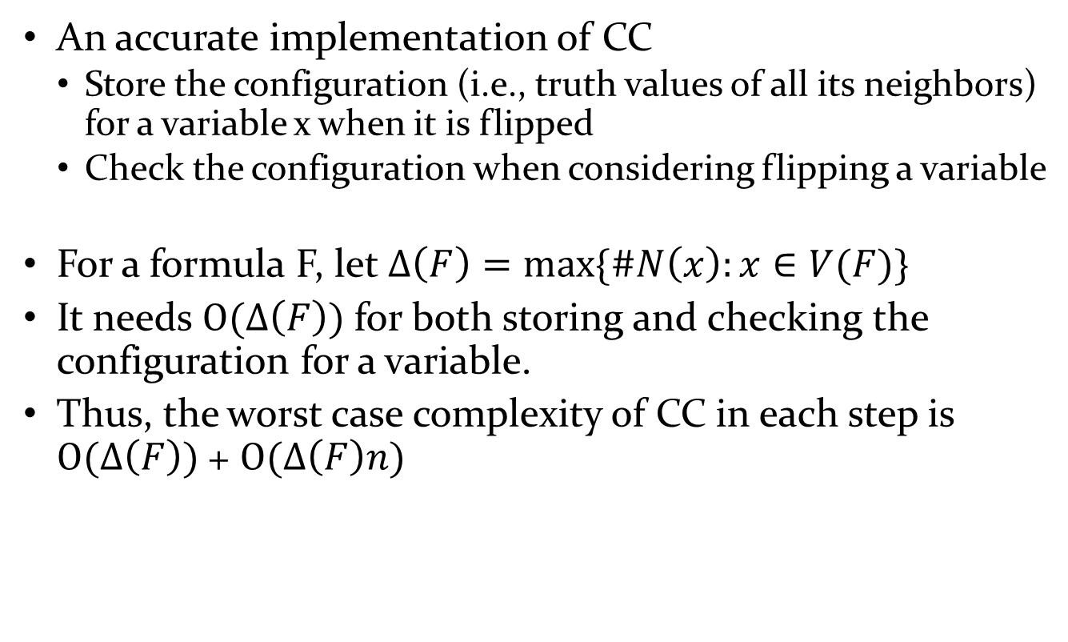
Naïve Implementation of CC
An accurate implementation of CC
Store the configuration (i.e., truth values of all its neighbors) for a variable x when it is flipped
Check the configuration when considering flipping a variable
For a formula F, let $Δ\left(F\right)=max⁡\{\#N\left(x\right):x∈V(F)\}$
It needs $O(Δ\left(F\right))$ for both storing and checking the configuration for a variable.
Thus, the worst case complexity of CC in each step is $O(Δ\left(F\right))$+ $O(Δ\left(F\right)n)$

Slide 8
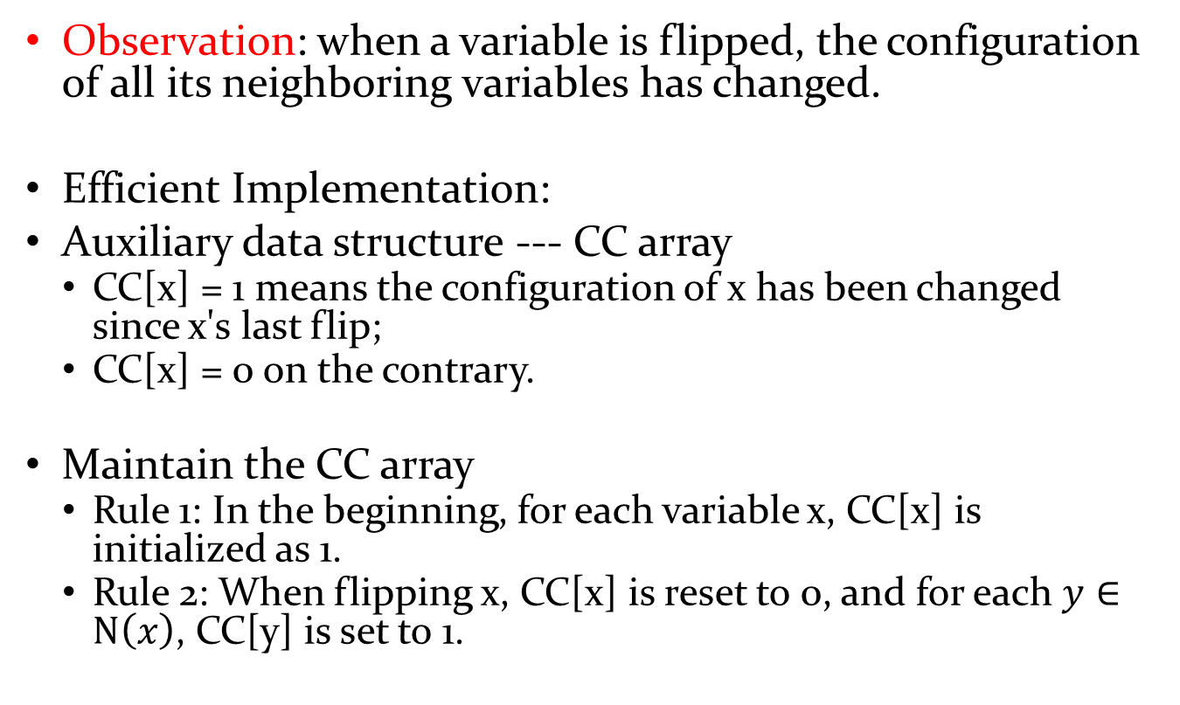
Efficient Implementation of CC
Observation: when a variable is flipped, the configuration of all its neighboring variables has changed.
Efficient Implementation:
Auxiliary data structure --- CC array
CC[x] = 1 means the configuration of x has been changed since x's last flip;
CC[x] = 0 on the contrary.
Maintain the CC array
Rule 1: In the beginning, for each variable x, CC[x] is initialized as 1.
Rule 2: When flipping x, CC[x] is reset to 0, and for each $y∈N\left(x\right)$, CC[y] is set to 1.

Slide 9
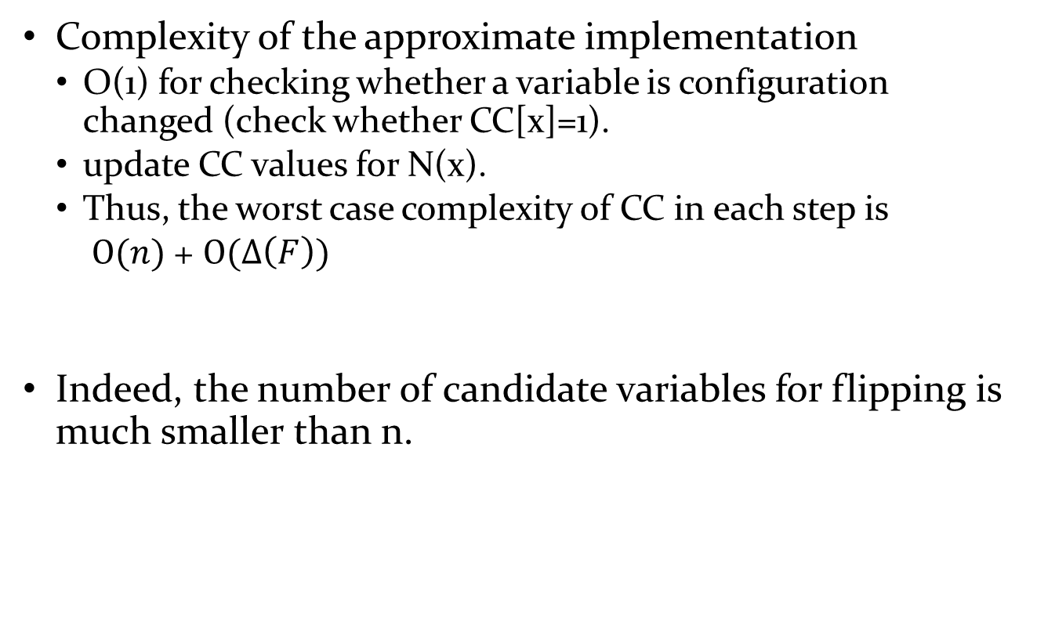
Efficient Implementation of CC
Complexity of the approximate implementation
O(1) for checking whether a variable is configuration changed (check whether CC[x]=1).
update CC values for N(x).
Thus, the worst case complexity of CC in each step is
$O(n)$+ $O(Δ\left(F\right))$
Indeed, the number of candidate variables for flipping is much smaller than n.

Slide 10
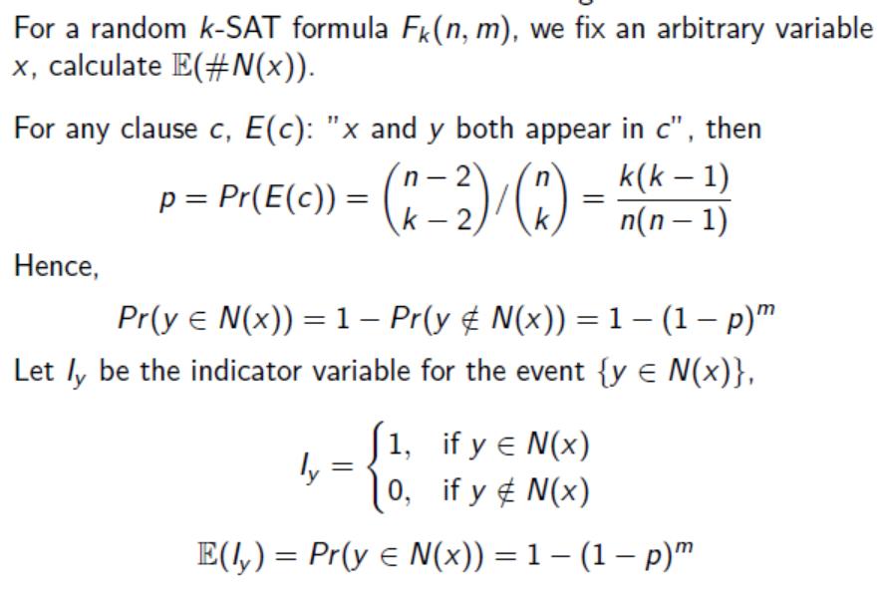
On the analysis of CC
When it works? When it does not work?
The effectiveness of CC is related to the neighborhood of variables.

Slide 11
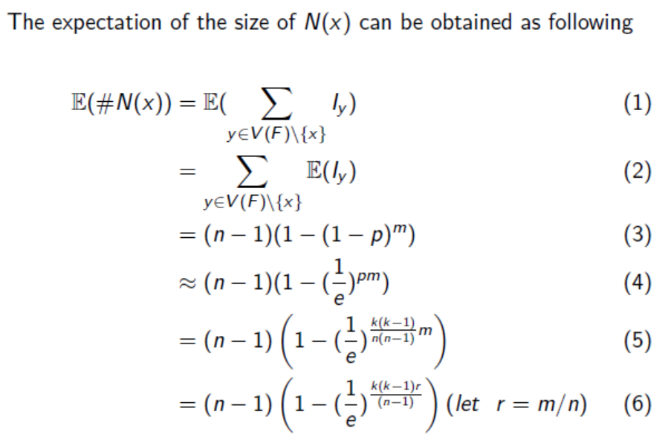

Slide 12
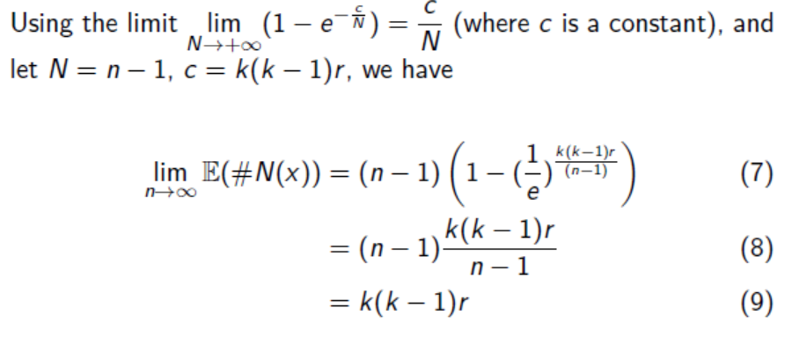

Slide 13
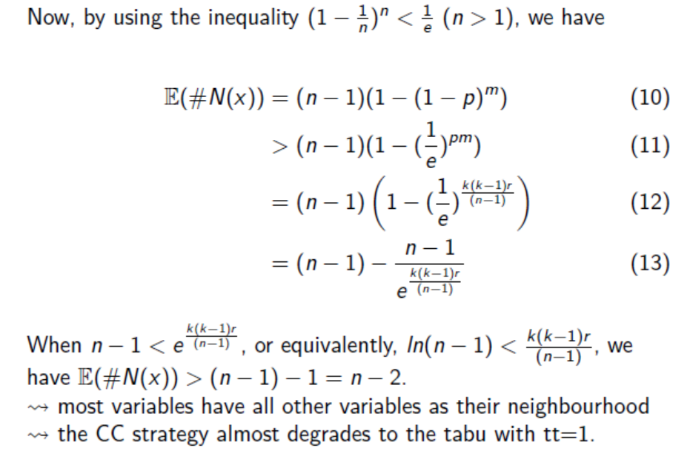

Slide 14
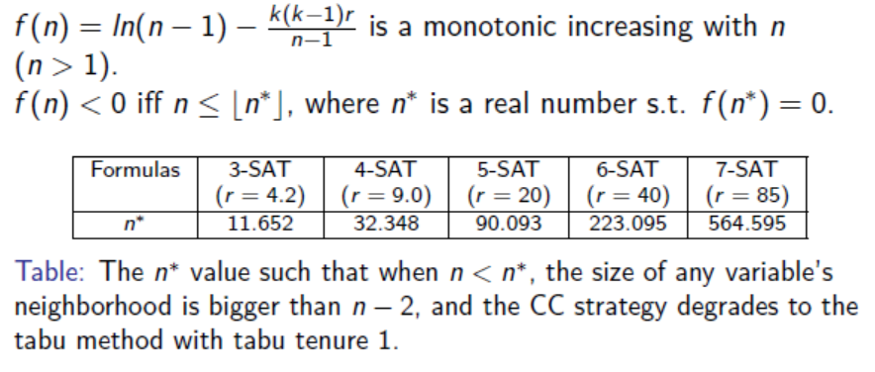
When CC Becomes Ineffective on random k-SAT

Slide 15
Variants of CC for SAT
The typical CC strategy for SAT is Neighboring Variables based CC.
We can have different CC variants by defining different configuration and checking methods.
In Clause States based CC (CSCC), the configuration of a variable x is a vector that consists of the states of all the clauses in which x appears.
Quantitative CC, the CC value is an integer.
Dynamic Threshold CC, a dynamic checking mechanism
Double CC, combining NVCC and CSCC

Slide 16
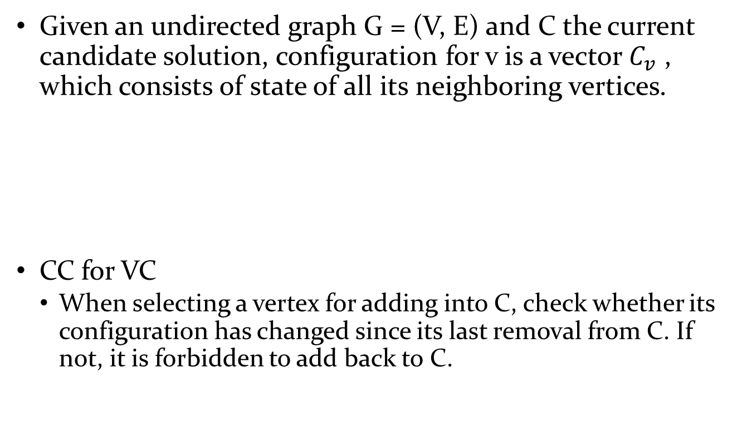
CC for Vertex Cover
Given an undirected graph G = (V, E) and C the current candidate solution, configuration for v is a vector $C_{v}$ , which consists of state of all its neighboring vertices.
CC for VC
When selecting a vertex for adding into C, check whether its configuration has changed since its last removal from C. If not, it is forbidden to add back to C.

Slide 17
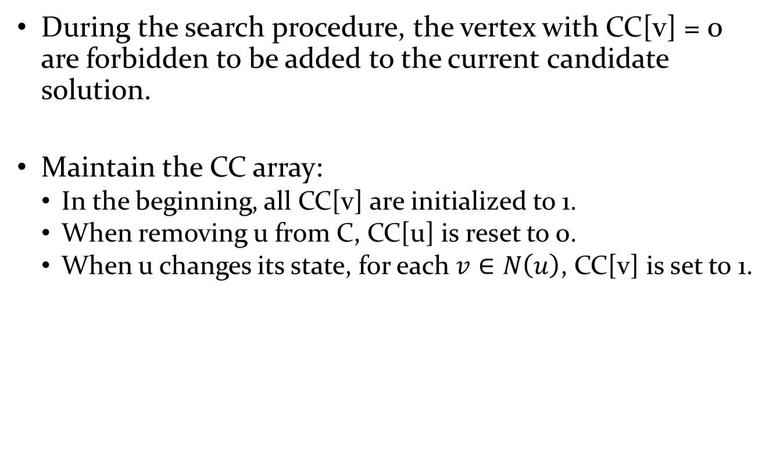
During the search procedure, the vertex with CC[v] = 0 are forbidden to be added to the current candidate solution.
Maintain the CC array:
In the beginning, all CC[v] are initialized to 1.
When removing u from C, CC[u] is reset to 0.
When u changes its state, for each $v∈N\left(u\right)$, CC[v] is set to 1.

Slide 18

Use CC in local search for VC
In each exchanging step
choose a vertex $u∈C$and a vertex $v∉C$ C with CC[v]=1;
$C≔\left[C\backslash \{u\}\right]∪\{v\}$
update CC values of u, v and their neighboring vertices;

Slide 19
On experiment analysis of CC
Studying the proportion of vertices with CC[v]=1 among all candidate vertices (or, proportion of vertices forbidden by CC).
Studying the cycles in a well known local search algorithm for minimum vertex cover named NuMVC.

Slide 20
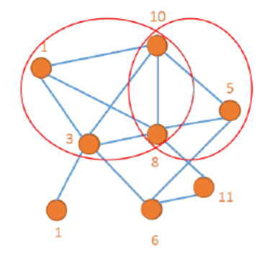
CC for Clique problems
Maximum weight clique problem (MWCP): each vertex is associated with a positive integer, the task is to find a clique with the largest weight.

Slide 21
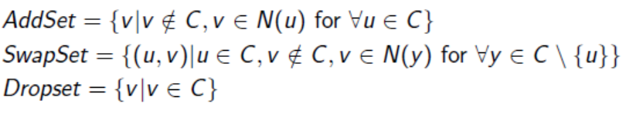
Three operators: Add, Swap, Drop
AddSet = {2},
Dropset = {1, 3, 4},
SwapSet = {(3,5),(1,6)}

Slide 22
Some considerations on CC for MWCP
Add: allow the selected vertex's neighbors to be added.
Drop: indicates no improving operation → local optimum → is rolling back by removing a vertex. => the removed vertex should not be encouraged to be added to the clique.
Swap: to another clique nearby, no sure a better clique
→adopt a conservative strategy: not encouraging more neighbouring vertices of the swapped vertices.

Slide 23
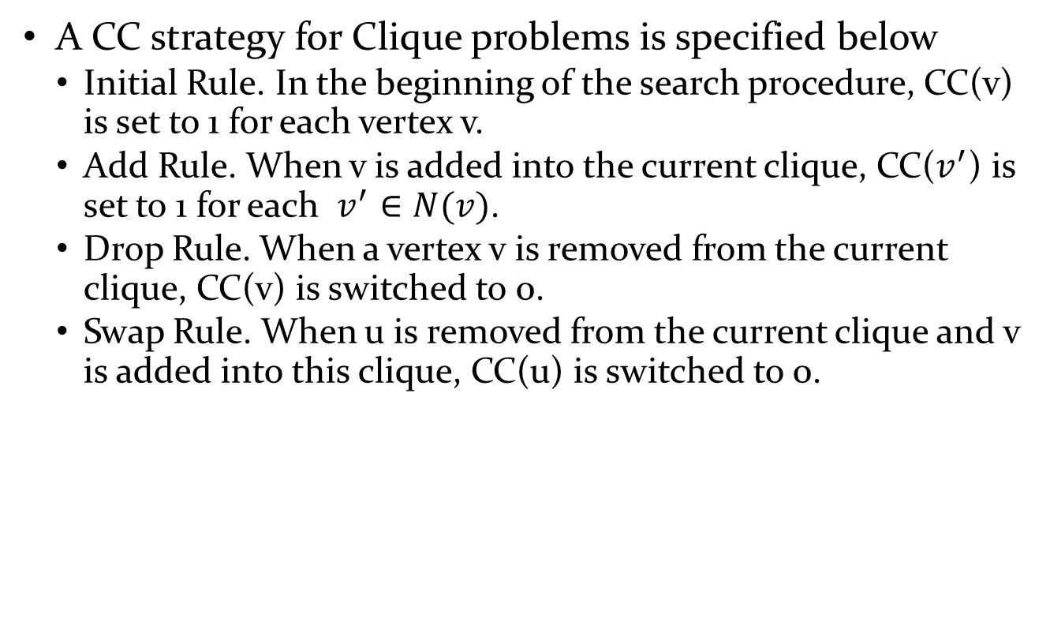
A CC strategy for Clique problems is specified below
Initial Rule. In the beginning of the search procedure, CC(v) is set to 1 for each vertex v.
Add Rule. When v is added into the current clique, CC($v^{′}$) is set to 1 for each $v^{′}∈N(v)$.
Drop Rule. When a vertex v is removed from the current clique, CC(v) is switched to 0.
Swap Rule. When u is removed from the current clique and v is added into this clique, CC(u) is switched to 0.

Slide 24
Can you think about CC for other problems?
Coloring
TSP
Set Cover
…

Slide 25
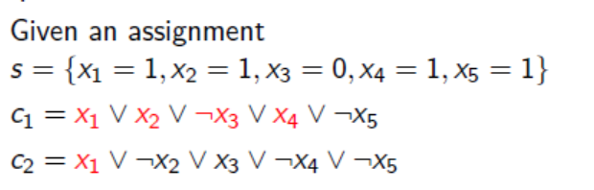
Satisfaction degree
Both clauses are satisfied.
But c1 is a 4-satised clause, while c2 has 1-satised.
1-satised clauses are the most endangered satisfied clauses. →critical clauses

Slide 26
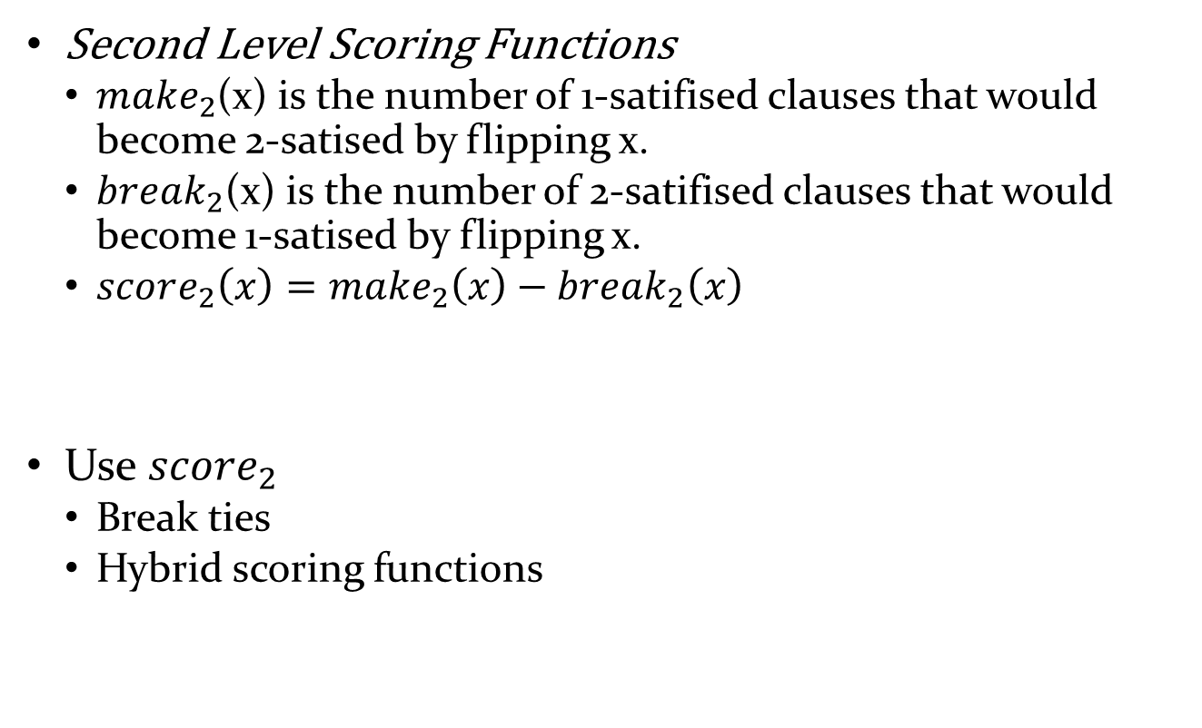
Second Level Scoring Functions
Second Level Scoring Functions
$make_{2}$(x) is the number of 1-satifised clauses that would become 2-satised by flipping x.
$break_{2}$(x) is the number of 2-satifised clauses that would become 1-satised by flipping x.
$score_{2}\left(x\right)=make_{2}\left(x\right)−break_{2}\left(x\right)$
Use $score_{2}$
Break ties
Hybrid scoring functions

Slide 27
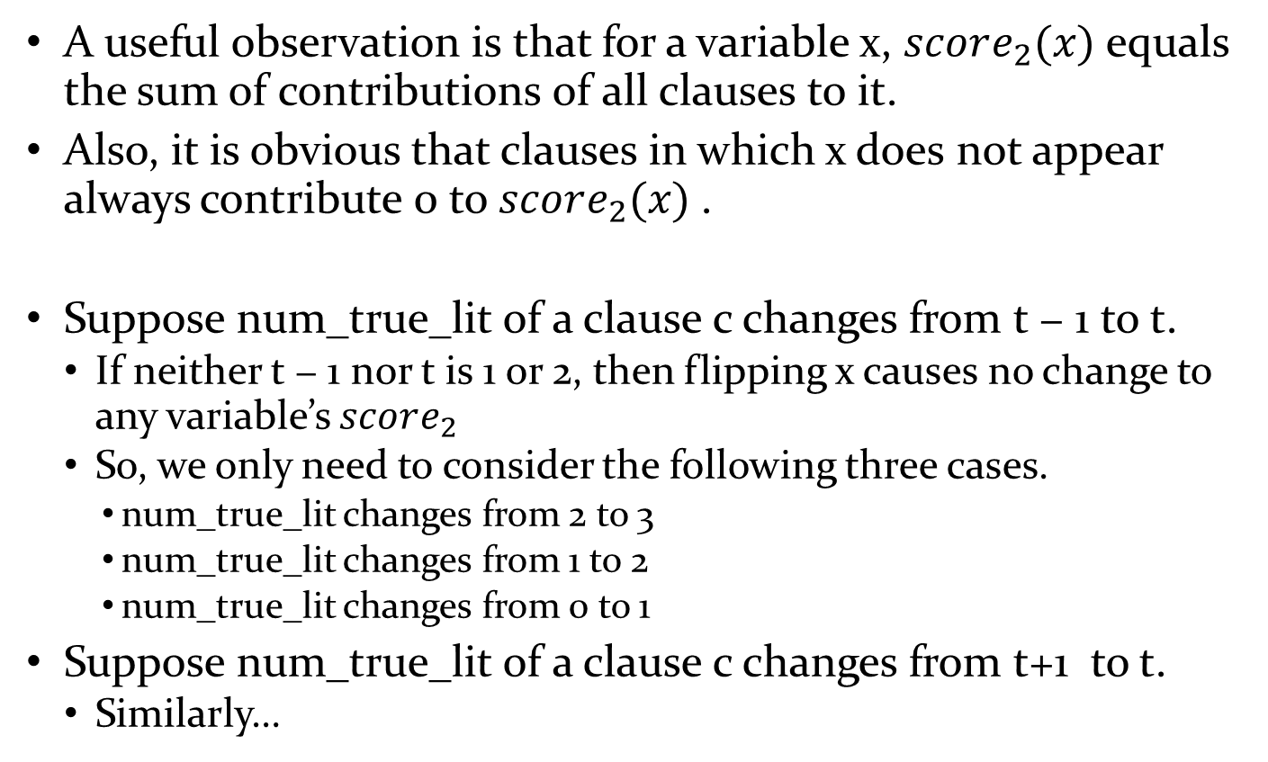
Implementation
A useful observation is that for a variable x, $score_{2}(x)$equals the sum of contributions of all clauses to it.
Also, it is obvious that clauses in which x does not appear always contribute 0 to $score_{2}(x)$.
Suppose num_true_lit of a clause c changes from t − 1 to t.
If neither t − 1 nor t is 1 or 2, then flipping x causes no change to any variable’s $score_{2}$
So, we only need to consider the following three cases.
num_true_lit changes from 2 to 3
num_true_lit changes from 1 to 2
num_true_lit changes from 0 to 1
Suppose num_true_lit of a clause c changes from t+1 to t.
Similarly…

Slide 28
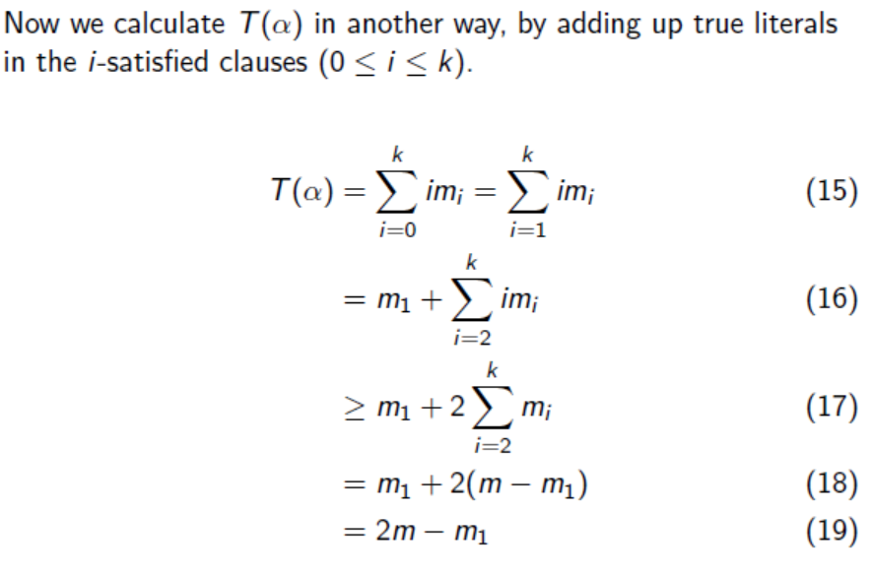

Analysis on second level score
Proposition: For a random 3-SAT formula F(n,m), under any solution s to the formula, the number of 1-satised clauses is more than m/2.
Proof: Since half literals are positive and half are negative, for any complete assignment, the number of true literals is half of all literals $T\left(α\right)=\frac{mk}{2}$ (k=3) (14)

Slide 29
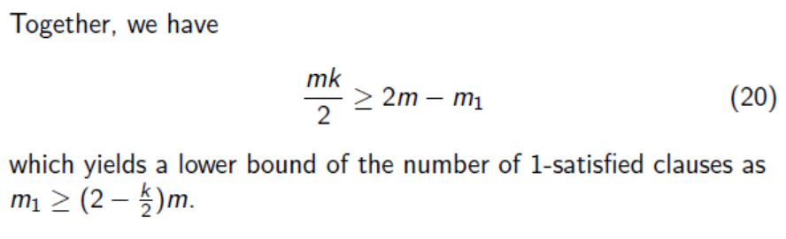

Slide 30
Other techniques
K-opt
Path relinking
Probabilistic Sampling

Slide 31
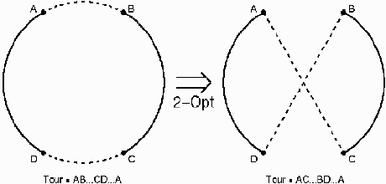
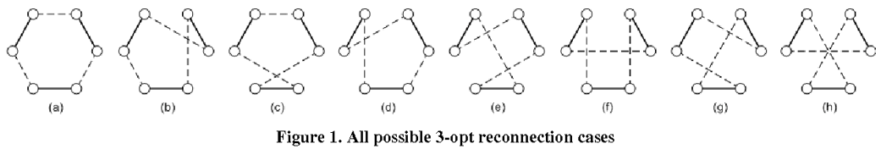
2-opt and 3-opt for TSP

Slide 32
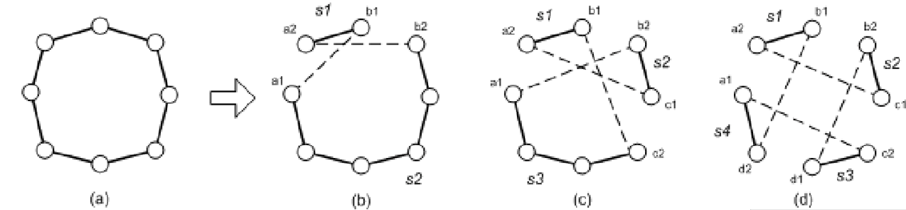
Combining various k-opt

Slide 33
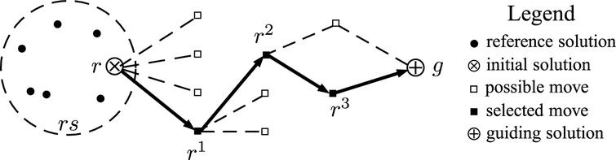
Path Relinking
To generate the desired paths, it is only necessary to select moves that perform the following role:
upon starting from an initiating solution, the moves must progressively
introduce attributes contributed by a guiding solution.
reduce the distance between attributes of the initiating and guiding solutions.

Slide 34
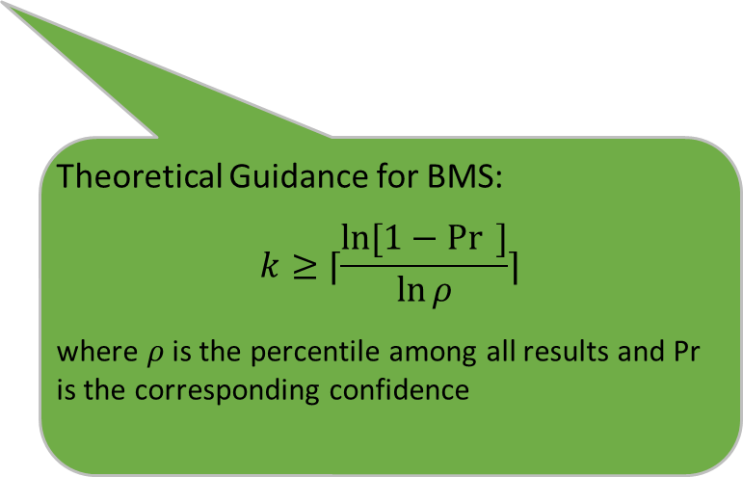

Sampling from candidate set
For solving large scale problem, selecting an element is time consuming as the candidate set is too large.
Sampling
Randomly sample $k$ elements
Select the one with largest $obj$ among $k$ samples
Theoretical Guidance for BMS:
$$k≥⌈\frac{\ln{[1−\operatorname{Pr}{ }]}}{\ln{ρ}}⌉$$
where $ρ$ is the percentile among all results and Pr is the corresponding confidence

